Slide 1
Capstone Engagement
Assessment, Analysis, and Hardening of a Vulnerable System

Slide 2
Table of Contents
This document contains the following sections:
01
Network Topology
02
Red Team: Security Assessment
03
Blue Team: Log Analysis and Attack Characterization
Hardening: Proposed Alarms and Mitigation Strategies
04

Slide 3
Network Topology
‹#›

Slide 4
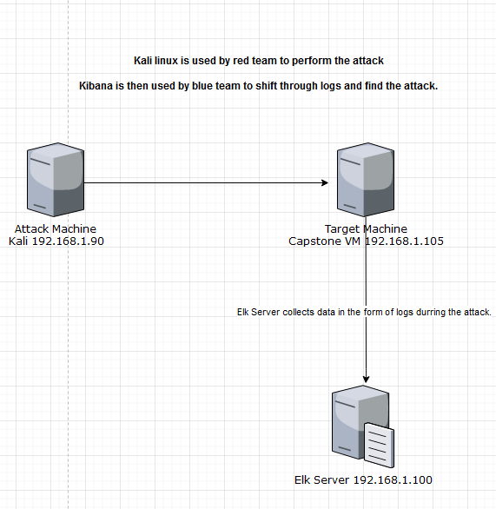
Network Topology
Network
Address Range: 192.168.1.0/24
Netmask: 255.255.255.0
Gateway: 192.168.1.1
Machines
IPv4: 192.168.1.90
OS: Linux
Hostname: Kali
IPv4: 192.168.1.105
OS: Linux
Hostname: Captstone
IPv4: 192.168.0.100
OS: Linux
Hostname: ELK
IPv4: 192.168.1.1
OS: Windows
Hostname: Red vs Blue - ML - REFVM

Slide 5

Red Team
Security Assessment
‹#›

Slide 6
Recon: Describing the Target
Nmap identified the following hosts on the network:
Hostname | IP Address | Role on Network
Kali | 192.168.1.90 | Attacking Machine used by red team
Capstone | 192.168.1.105 | Vulnerable Machine
ELK | 192.168.1.100 | Collects logs to be analyzed by a SOC analyst or blue team
Red Vs Blue ML-REFVM | 192.168.1.1 | The virtual machine that contains the kali, capstone, and elk vms. Blue team accesses kibana through here.

Slide 7
Vulnerability Assessment
The assessment uncovered the following critical vulnerabilities in the target:
Vulnerability | Description | Impact
Open Port 80, Open Port 22 | Port 80 (HTTP) is one of the most commonly open ports on a server, and thus a common target for hackers. | An attacker using a port scan to find which ports are open to gain access to a system through that port.
Weak Password | The hidden directory had a weak password. Weak Passwords are easily brute forced or cracked. | Red team gained access to the hidden directory by cracking it with Hydra.
Hidden Directory | A hidden directory was found that contained sensitive data. While hidden from the public it was vulnerable to hacking. | Red team gained access to the hidden directory leading to the hash for the webdav password allowing access to the web dav connection
WebDAV Connection | The WebDAV protocol enables users to change, create or move files on the server. | An attacker can use this connection to upload a malicious script directly to the server.
Notes:
It is silly but red team had access to Port 22 as well as Port 80. So it was simply a matter of SHHing into port 22 and we basically had root access to the target system and were able to find the flag. But being that this is an academic endeavour red team carried on with the attack as suggested in order to create logs for kibana. So that on day two we may analyze those logs as part of the blue team portion of the project.

Slide 8
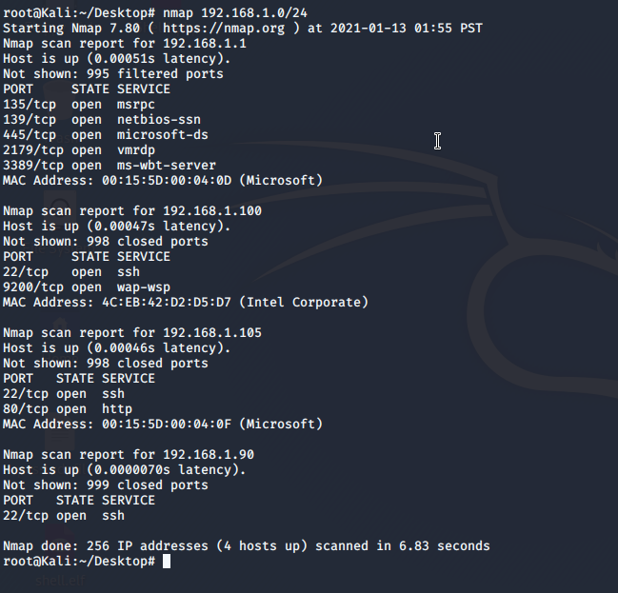
Exploitation: [Open Port 80, Open Port 22]
01
02
03
Tools & Processes
Nmap was used to scan the network and discover vulnerable open ports.
Achievements
Red Team gained access to the target machine via port 80. This allowed Red Team to explore the web directories. Through Port 22 Red Team managed to SSH directly into the target machine gaining immediate root access to the machine. Through this the flag was found.

Slide 9
Exploitation: [Weak Password]
01
02
Tools & Processes
Hydra was used to brute force the password to the hidden directory
Achievements
The password to the Hidden Directory was cracked. Giving Red Team access to the sensitive Hash within. That hash was cracked by the website crackstation.net
Notes:
I couldn't fit the screen shot in some cases nicely on a single slide. So I crafted another slide to fit the entire screen shot nicely. Easily readable. Viewable.

Slide 10
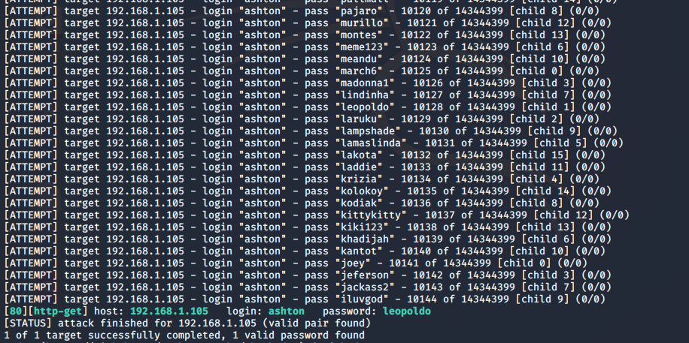
Exploitation: [Weak Password]
03

Slide 11
Exploitation: [Hidden Directory]
01
02
Tools & Processes
Red Team Initially discovered the hidden directory through DIB. Hydra was used to crack it’s password and gain access to the data within.
Achievements
The password to the Hidden Directory was cracked. Giving Red Team access to the sensitive Hash within. That hash was cracked by the website crackstation.net This allowed Red Team access to the WebDav server in order to upload a malicious payload through metasploit.

Slide 12
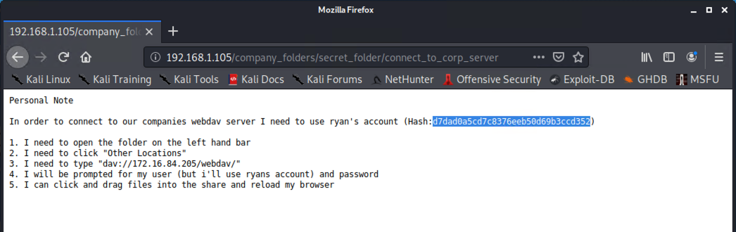
Exploitation: [Hidden Directory]
03

Slide 13
Exploitation: [WebDAV Connection]
01
02
Tools & Processes
Hydra was used to brute force into the webdav server
Achievements
The WebDAV Connection allowed us to upload a reverse shell payload which when triggered gave red team access to the target machines root directory. From there the flag was found.

Slide 14
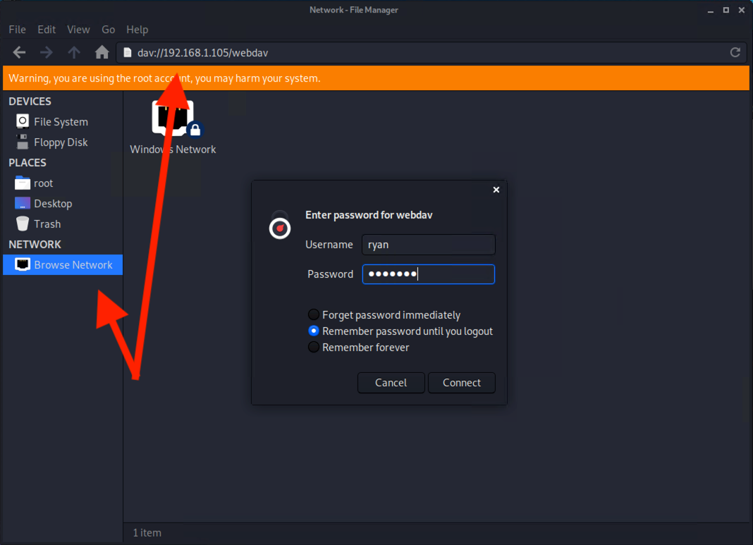
Exploitation: [WebDAV Connection]
03

Slide 15

Blue Team
Log Analysis and Attack Characterization
‹#›

Slide 16
Analysis: Identifying the Port Scan
The port scan occured at 1300 on 2020-12-14 The fact that the source.ip tried to create multiple TCP connections with multiple destination ports was an anomaly. Top hosts creating traffic shows the kali linux source host 192.168.1.90 creating the majority of traffic and is an overall massive spike in traffic. This graph when combined with the HTTP transaction graph that shows a large spike in HTTP traffic which is outside the norm are both evidence of red teams use of port 80 during the attack.

Slide 17
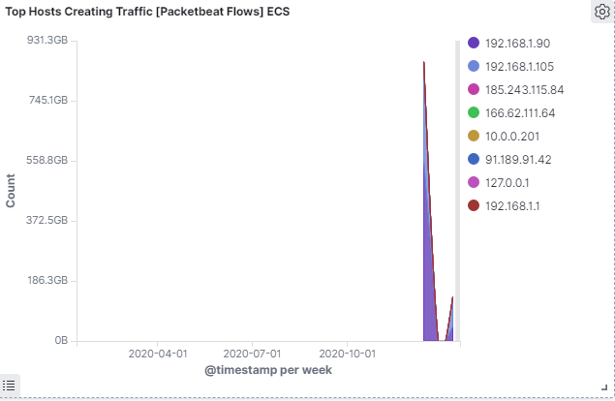
Analysis: Identifying the Port Scan

Slide 18
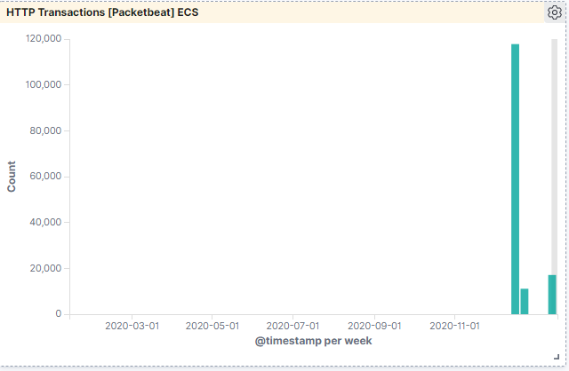
Analysis: Identifying the Port Scan

Slide 19
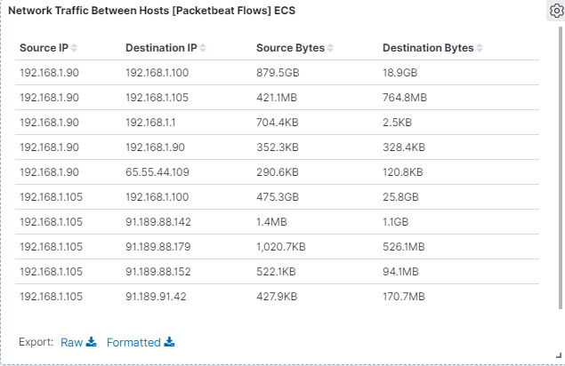
Analysis: Identifying the Port Scan
This graph shows a massive amount of 879.5 GB worth of packets sent by the attacking kali linux machine on the target machine during the attack This is indicative of the totality of the attack itself and time spent on the target machine from the attacking machine.
Notes:
Forgive me for how sloppy these power points are. I hadn’t done powerpoint since college and am rusty at it. I tried ot make them as neat as possible.

Slide 20
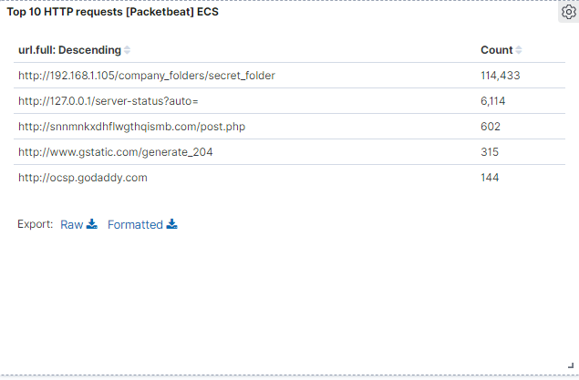
Analysis: Finding the Request for the Hidden Directory
The request occured at 1334 on 2020-12-14
114,443 HTTP requests were made to the secret_folder

Slide 21
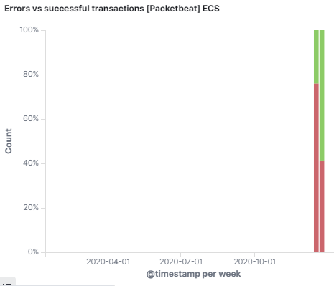
Analysis: Uncovering the Brute Force Attack
The large amount of errors vs successful transactions that occurred around 1300 is evidence of red teams brute force attack. Almost 80% of transactions were errors during this time.

Slide 22
Analysis: Uncovering the Brute Force Attack
The HTTP status code 401 shows unauthorized requests of which there are 114,409 such requests. This information when combined with the large ratio of errors to successful transactions supports the prior conclusion as a solid indicator for the brute force attack done by the red team during the attack.
In the top 10 HTTP requests there are 114,443 requests for the secret folder. The difference between the 114,409 unauthorized requests “status code 401” and the total 114,443 HTTP requests with the url http://192.168.105/compnay_folders/secret_folder shows 34 total successes indicating the brute force attack was a success.

Slide 23
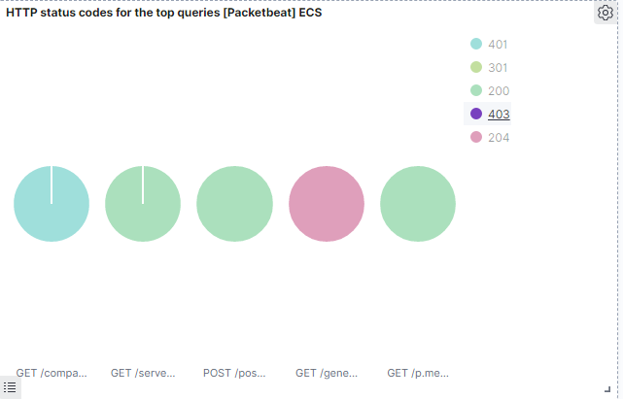
Analysis: Uncovering the Brute Force Attack

Slide 24
Analysis: Finding the WebDAV Connection
A total of 16 HTTP requests were made to the webdav directory
Notes:
When I originally did this I am sure there were thousands of http requests to the webdav directory. But I had to redo this project working on it days or weeks later or whatever from the initial day. And adding the data back for some reason some of the data I original had and was able to find is missing compared to the original time I worked on the project. I would basically have to redo the red team day from scratch and add those logs back into kibana to regain that data and I don’t have time for that. Realistically I would have taken a screen shot of the evidence and showing my search through kibana were I found the actual evidence of not just red teams access to the web dav but the actual creation of the reverse shell payload which I managed to find initially on the day we worked on the project in class. But since I no longer have that data i’m being pragmatic here and not bothering. Which is why this slide looks like total shit.

Slide 25
Blue Team
Proposed Alarms and Mitigation Strategies
‹#›

Slide 26
Mitigation: Blocking the Port Scan
A IDS or IPS can and should be configured to specifically alert the SOC to indicators of a port scan or shut the attack down entirely. It Must be configured with an acceptable threshold such a 10 port scans in one minute or 100 consecutive ping requests in order to limit false positives.
A firewall in conjunction with a IDS. The firewall can manage the visibility of ports.
Enable only the traffic needed to access internal hosts. Deny everything else.
Hiding services on obscure ports
Honey Pots
OS Spoofing
Port Knocking Require two key factor authentication to SSH into the system.
Notes:
Was it called a false negative? I think. Where its a positive and yet the SIEM or Analyst doesn’t pick it up. I think so.
https://nmap.org/book/nmap-defenses-trickery.html
Bring up difference between IDS IPS
A technique called port knocking has recently become popular as a way to hide services from potential attackers. The method is well described on the front page of http://www.portknocking.org/:
Port knocking is a method of establishing a connection to a networked computer that has no open ports. Before a connection is established, ports are opened using a port knock sequence, which is a series of connection attempts to closed ports. A remote host generates and sends an authentic knock sequence in order to manipulate the server's firewall rules to open one or more specific ports. These manipulations are mediated by a port knock daemon, running on the server, which monitors the firewall log file for connection attempts that can be translated into authentic knock sequences. Once the desired ports are opened, the remote host can establish a connection and begin a session. Another knock sequence may be used to trigger the closing of the port.
Several programs have been developed specifically to trick Nmap OS detection. They manipulate the host operating system to support custom responses to Nmap probes. In this way, a Linux PC can be made to resemble an Apple LaserWriter printer or even a webcam. IP Personality, released in 2000, is one of the most popular systems. It extends the Linux Netfilter framework to support these shenanigans. Unfortunately, it has not been updated since April 2002 and may not work on kernel versions beyond 2.4.18.
Honey pots are high maintenance and expensive.. risky
But used by corporations
Bring up the difference between UDP scans and TCP scans
SYN ACK ext..
https://searchsecurity.techtarget.com/definition/Port-Scan

Slide 27
Mitigation: Finding the Request for the Hidden Directory
An alert could be set when the directory is accessed by any IP outside of a list of approved IPs. A threshold of >=1 is acceptable. Since no one should be accessing this directory in the first place aside from those with the privileges to do so.
Remove the hidden directory entirely
If not then make the password for the directory more difficult to crack by increasing its complexity, length ext.
Encrypting the directory with a key or password that only those in the need to know have is also a possibility
Notes:
How about a SOC with a SIEM or an internally run SIEM to harden your system?

Slide 28
Mitigation: Preventing Brute Force Attacks
An alert could be set for 50 unsuccessful login attempts or unauthorized HTTP requests “code 401”. Based on a baseline or average amount of failed login attempts over a given period of time of 20.
A complex and difficult to crack password makes successful brute force attacks more difficult and time consuming to achieve. Captcha is often used to harden systems
Account lockout policy on too many failed login attempts. IP address lockout after too many consecutive failed login attempts.
Delaying the time allowed between password attempts makes an attack more time consuming and easier to spot
Notes:
Since this is academic they dont really give you a baseline to work with so I just winged it. I made a baseline up hypothetically to work with.
This is basic security. It is basic fundamental stuff. None of this goes into the complexities or advanced hacking techniques which are used that bypass standard defenses……. https://portswigger.net/web-security/authentication/securing

Slide 29
Mitigation: Detecting the WebDAV Connection
An alert could be set when the directory is accessed by any IP outside of a list of approved IPs. A threshold of >=1 is acceptable. Since no one should be accessing this directory in the first place aside from those with the privileges to do so.
Use a web application firewall Implement HTTPS and require authentication. Password or client certificates.
Notes:
https://serverfault.com/questions/391633/webdav-security-and-hardening Local Auth
HTTP traffic is unencrypted and can be read with a sniffer or wireshark ext.
Anyone can read it.

Slide 30
Mitigation: Identifying Reverse Shell Uploads
Have a company policy that determines which type of files can and cannot be uploaded through the webdav. Create rules that alert the SOC to unauthorized and authorized file uploads.
Create a rule that alerts to traffic moving through port 4444 the default port used by metasploit listeners Set a threshold of =>1
Limit which ports are open and which IP addresses have access to open ports Use hashing to support data integrity Have regular system backups Use Falco and Sysdig Secure, applications designed to detect reverse shells Set up a proxy server with tightly controlled restrictions Endpoint protection such as TXhunter Remove unnecessary interpreters
Notes:
https://www.netsparker.com/blog/web-security/understanding-reverse-shells/ https://triagingx.com/img/website_images/resource_images/776444019_detectreverseshell.pdf Windows Powershell is often used by hackers to write scripts ext on the very machine they target. Hidden within the power shell?

